Slide 1
Centroids and the Center of Mass via Composite Parts
Dr. Jacob Moore
Associate Professor of Mechanical Engineering
Penn State Mont Alto

Slide 2
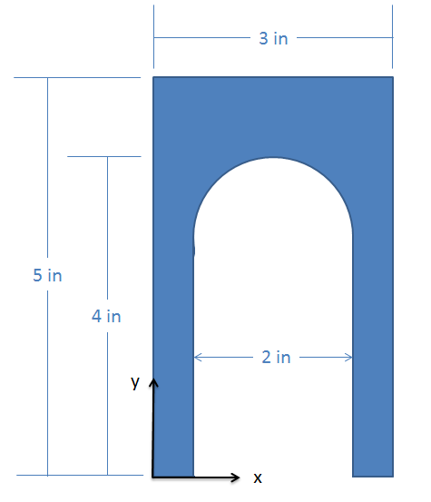
Alternate Methods for Finding the Centroid
The centroid of a shape can always be found via integration, however performing the calculations by hand for more complex shapes can become unmanageably difficult.
One solution is to use the method of composite parts, taking advantage of someone else’s previous work in computing the integrals.
Another solution is to use software tools, such as a CAD software, that can calculate these values for you.

Slide 3
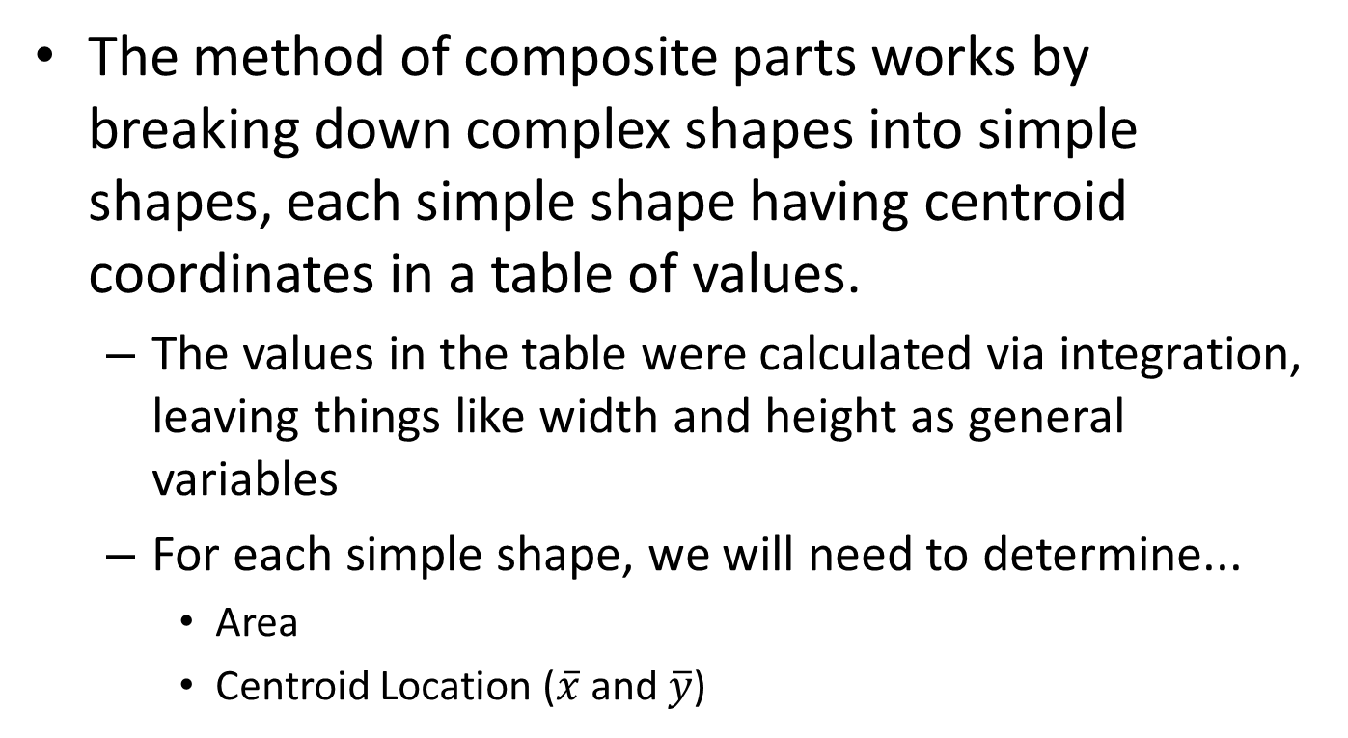
Finding the Centroid via the Method of Composite Parts
The method of composite parts works by breaking down complex shapes into simple shapes, each simple shape having centroid coordinates in a table of values.
The values in the table were calculated via integration, leaving things like width and height as general variables
For each simple shape, we will need to determine...
Area
Centroid Location ($\overline{x}$ and $\overline{y}$)

Slide 4
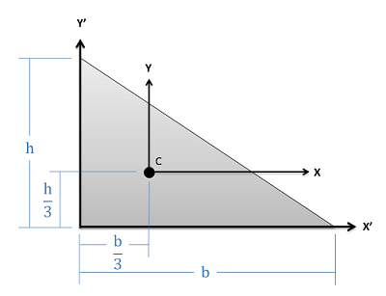
Centroid Tables
The centroid tables provide a generalized centroid location, that will need to be adapted to the exact situation you have.
Let’s use the figure from the table to determine the location of this triangle’s centroid…
Right Triangle from Centroid Table
Triangle in Our Problem
y
4 in
x
6 in

Slide 5
Using the Method of Composite Parts
To use the method of composite parts, we will first need to break the shape down into simple parts.
Each simple part you create must be in your centroid table.
Regular areas will count as positive areas
Holes or Cutouts will count as negative areas
1 .
2
3

Slide 6
Y
.
2
X
3
1

Slide 7
Using the Method of Composite Parts
Next we will record the area, x centroid coordinate, and the y centroid coordinate in a table.
Remember to take the orientation and position of each shape into account when finding the centroid of the shape. The centroid locations should all be relative to the same point.
Shape | Area | $$\overline{X}$$ | $$\overline{Y}$$
1
2
3
1 .
2
Y
X
3

Slide 8
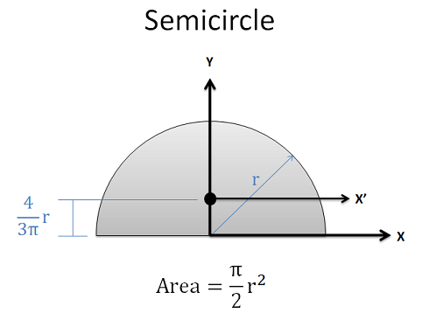
Centroid Locations
Make sure you label all centroid locations with respect to the origin point.
This will often involve reorienting or interpreting the centroid table diagrams
1 .
2
Y
X
3

Slide 9
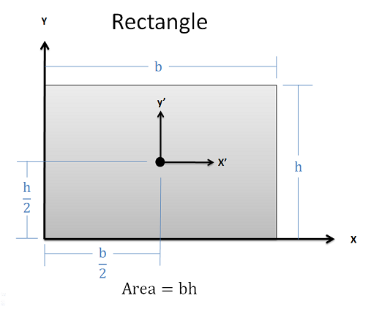
Centroid Locations
Make sure you label all centroid locations with respect to the origin point.
This will often involve reorienting or interpreting the centroid table diagrams
1 .
2
Y
X
3

Slide 10
Using the Method of Composite Parts
Once we have these values, we can use the formulas shown below to calculate the x and y coordinates of the centroid for the whole shape.
$$\overline{x}=\frac{\sum_{1}^{i}{A_{i}\overline{x_{i}}}}{\sum_{1}^{i}{A_{i}}}$$
$$\overline{y}=\frac{\sum_{1}^{i}{A_{i}\overline{y_{i}}}}{\sum_{1}^{i}{A_{i}}}$$
Shape | Area | $$\overline{X}$$ | $$\overline{Y}$$
1
2
3
1 .
2
Y
X
3

Slide 11
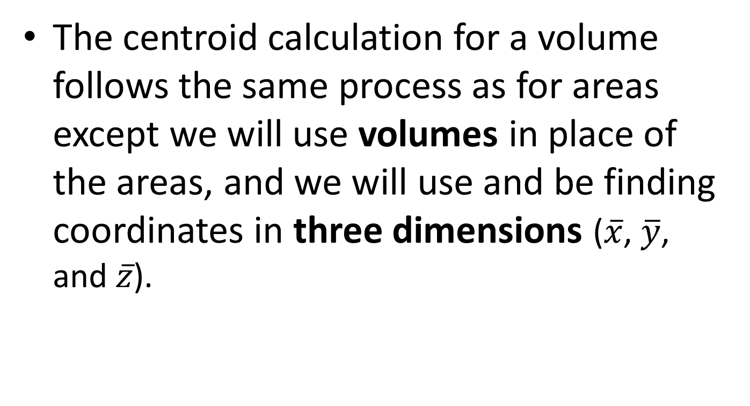
Centroid of a Volume via Composite Parts
The centroid calculation for a volume follows the same process as for areas except we will use volumes in place of the areas, and we will use and be finding coordinates in three dimensions ($\overline{x}$, $\overline{y}$, and $\overline{z}$).

Slide 12
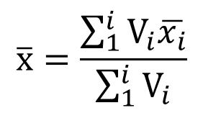
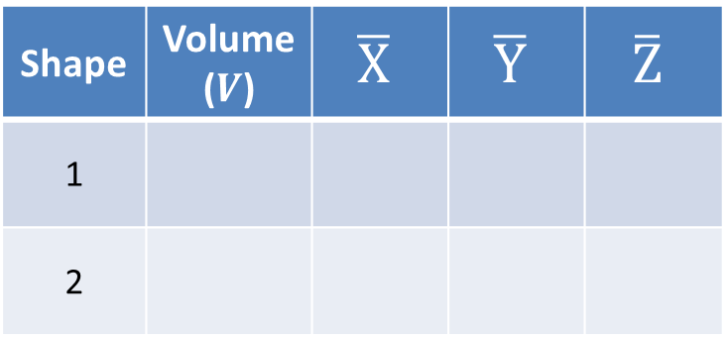
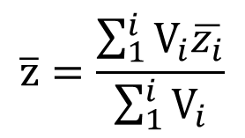
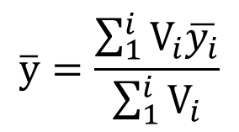
Centroids in 3D
Break the volume down into shapes we can look up in our table of centroids.
Cutouts and holes are represented by negative volumes
Remember to take into account the orientation and placement of the different pieces.
Shape | Volume ($V$) | $$\overline{X}$$ | $$\overline{Y}$$ | $$\overline{Z}$$
1
2
1
2
$$\overline{x}=\frac{\sum_{1}^{i}{V_{i}\overline{x_{i}}}}{\sum_{1}^{i}{V_{i}}}$$
$$\overline{y}=\frac{\sum_{1}^{i}{V_{i}\overline{y_{i}}}}{\sum_{1}^{i}{V_{i}}}$$
$$\overline{z}=\frac{\sum_{1}^{i}{V_{i}\overline{z_{i}}}}{\sum_{1}^{i}{V_{i}}}$$

Slide 13
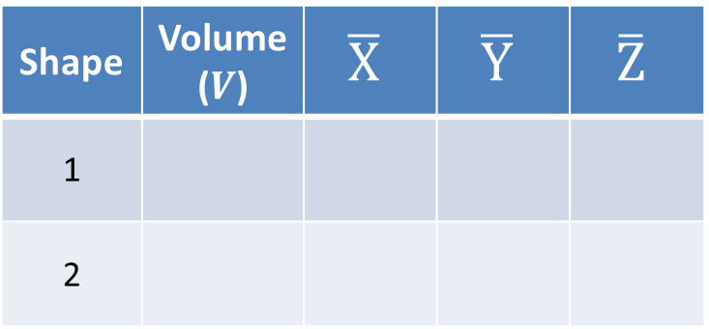
Y
1
Shape | Volume ($V$) | $$\overline{X}$$ | $$\overline{Y}$$ | $$\overline{Z}$$
1
2
2
X
Z

Slide 14
Center of Mass
Finally, the center of mass calculation with the method of composite parts is the same as the centroid of a volume calculation, except we will be using mass in place of the volume.

Slide 15
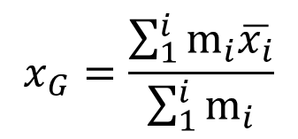
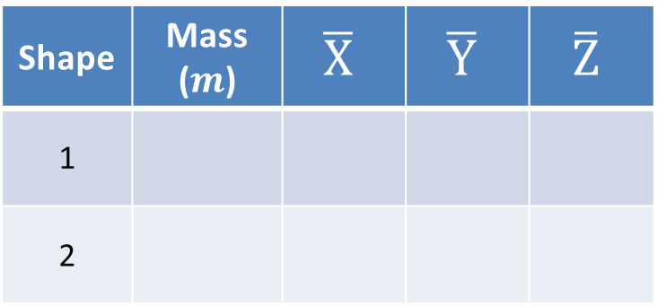
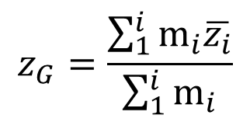
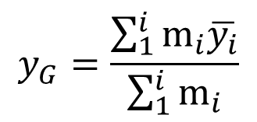
Center of Mass
For the Center of Mass we will use pretty much the same process except...
We will use the mass of each part in our table, which may be calculated as density times volume.
The mass of a cutout is the mass of material that would be removed.
1
Shape | Mass ($m$) | $$\overline{X}$$ | $$\overline{Y}$$ | $$\overline{Z}$$
1
2
2
$$x_{G}=\frac{\sum_{1}^{i}{m_{i}\overline{x_{i}}}}{\sum_{1}^{i}{m_{i}}}$$
$$y_{G}=\frac{\sum_{1}^{i}{m_{i}\overline{y_{i}}}}{\sum_{1}^{i}{m_{i}}}$$
$$z_{G}=\frac{\sum_{1}^{i}{m_{i}\overline{z_{i}}}}{\sum_{1}^{i}{m_{i}}}$$

Slide 16
Thanks for Watching
See other engineering mechanics videos and access the full tool at…

Slide 17
Worked Example
Use the method of composite parts to determine the centroid of the shape shown below.
y
4 in
3 in
d = 2 in
1.5 in
x
2 in
8 in

Slide 18
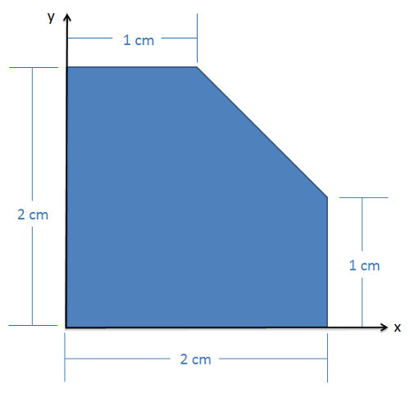
Worked Example
Use the method of composite parts to determine the centroid of the shape shown below.

Slide 19
Worked Example
Use the method of composite parts to determine the centroid of the shape shown below.

Slide 20
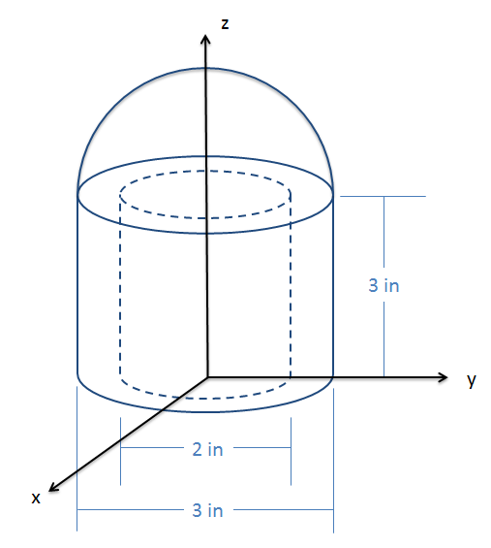
Worked Example
The shape shown to the right consists of a solid hemisphere on top of a hollowed out cylinder. Determine the centroid coordinates of this volume.

Slide 21
Worked Example
A spherical tank with an outside diameter of two meters and a wall thickness of .01 meters is half filled with water. Determine the mass, and the height of the center of mass, for the half-filled tank as shown below.
2 m
Steel Density = 8050 kg/m³
Thickness of
tank = .01 m
Water Density = 1000 kg/m³
Z
X

